Slide 1
The Implementation
ER system introduction & issues

Slide 2
ER information system intruduction
Brain storm & hope on the horizon
Initializing with the psychologic poll
Emotion indicators v1.0
Emotion indicators v2.0
Applying ranking theory

Slide 3
ER information system intruduction
Brain storm & hope on the horizon
Emotion status can be break down into indicators
That's how we react to incidents & environment
What's important can be polled
(according to the psychology teacher)

Slide 4
ER information system intruduction
Initializing with the psychologic poll

Slide 5
ER information system intruduction
Initializing with the psychologic poll
Top 10
学习压力 / Academic Pressure | 14 |  | 追星/偶像 / Stars | 7
父母/家庭关系 / Parents, Family Relations | 10 |  | 学业 / Academic Performance | 6
朋友/人际关系 / Firends & Personal Relations | 10 |  | 天气 / Wheather | 5
考试测试 / Tests & Exams | 8 |  | 周边环境 / Physical Environment | 4
恋爱/异性 / Love | 7 |  | 托福成绩 / TOEFL Scores | 4

Slide 6
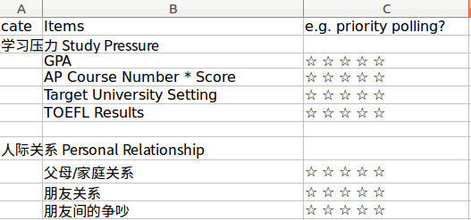
ER information system intruduction
Emotion indicators v1.0
the first intuitive thinking

Slide 7
ER information system intruduction
Emotion indicators v1.0
tried a flexible design
Video A: the indicator design pattern

Slide 8
ER information system intruduction
Emotion indicators v1.0
so we need a flexible design
Video B: the poll & quiz calculation

Slide 9
ER information system intruduction
Emotion indicators v1.0
Results: extremely not user friendly
Too much questions in one quiz
Questions are hardly answerable

Slide 10
ER information system intruduction
Emotion indicators v1.0
Results: extremely not user friendly
Too much questions in one quiz
Questions are hardly answerable

Slide 11
ER information system intruduction
Emotion indicators v2.0
Changes:
Add & divide the questions into multiple equivalent parts
Keep each quiz has only 8 – 9 questions
Simplify the question types to 1 type: 5 star ranking

Slide 12
ER information system intruduction
Emotion indicators v2.0
Changes:
Add & divide the questions into multiple equivalent parts
Keep each quiz has only 8 – 9 questions
Simplify the question types to 1 type: 5 star ranking

Slide 13
ER information system intruduction
Emotion indicators v2.0
Changes:
Divide the questions into multiple equivalent parts
Keep each quiz has only 8 – 9 questions
Simplify the question types to 1 type: 5 star ranking

Slide 14
ER information system intruduction
Applying ranking theory
TODO …

Slide 15
Issues
Data, team, knowledge and more …

Slide 16
Why failed?
A user friendly application is much more expensive than expected
Timeline & the process disappointed everyone
…

Slide 17
Why failed?
The most important:
I need a solid understanding of emotion!

Slide 18
Why failed?
Guessing the future direction:
Is knowledge acquiring / cognition the answer?
e.g. like what Stoicism tells us:
What happens in the real world can not be controlled,
but what we feel is controllable.

Slide 19
Why failed?
Guessing the future direction:
Or supervised learning?
An easy step to adapt to supervised learning process:
- Have the users themselves rank their emotions

